Slide 1
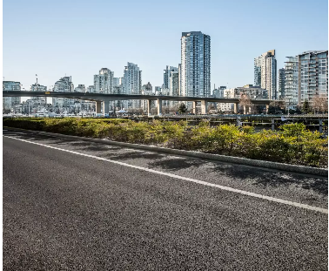
Road
Roads, Overpasses, Bridges
From tricky city streets to expansive highway systems, we can support roadway infrastructure projects of any size, anywhere. Our talented team and top-of-the-line tools enable us to be flexible, resourceful, and responsive to client needs.
The surveying, mapping, and geomatics services that we deliver help bring operational and cost efficiencies to the construction of roads, overpasses, and bridges. With over one hundred years in the surveying industry and offices from Western Canada to Ontario (RAQS certified), we’re well-equipped to produce reliable results that are on schedule and mitigate risks, regardless of the scope or region. Some of our road focused services include:
Land Surveying Services
Topographic corridor mapping
Road use and access plans
Traffic accommodation strategies
Right of way legal surveying
3D mobile scanning and modelling services
Surveys to support condition assessment of roads, bridges, and assets
Environmental Management
Pre-site and pre-disturbance assessments
Wildlife sweeps and management plans
Third-party agreements and acquisitions
Water Act regulatory process
Construction Services
Calculation of coordinates and grades
Highway and freeway staking
Settlement and deformation monitoring
As-built surveys of road and related construction
Advanced Technologies / With the benefits of improved safety, compressed schedules, and reduced costs, we have advanced technologies — mobile mapping systems (MMS), global navigation satellite systems (GNSS), robotic total stations, multistations, and more — to collect high-precision data, and provide monitoring services for a diverse range transportation projects.
For more information, visit our website or get in touch with your local office at geoverra.com/contact
BRITISH COLUMBIA / ALBERTA / SASKATCHEWAN / MANITOBA / ONTARIO
GEOVERRA.COM

